Slide 1
Emerging Trends in Gynaecological Surgery: What’s on the Horizon?
Imaralu JO
MBCHB, MPH, MD, FMCOG, FMAS, DMAS

Slide 2
Outline
Historical trends in gynaecological surgery [innovations in basic sciences, instruments & surgical techniques]
Drivers of change in gynaecological surgery
How is the practice of gynaecological surgery responding to the demands?
The impact of the emerging trends
Changes in specific aspects of gynaecological surgery
The future of gynaecological surgery
Artificial intelligence in gynaecological surgery
What the different team members should expect
conclusion

Slide 3
Gynaecological surgery: pioneer in surgical innovations
Gynaecological surgery has witnessed a rapid progression in contemporary times. A high proportion of Innovations in surgical care has been contributed by gains in gynaecological surgery

Slide 4
Historical trends in gynaecological surgery- Basic science of gynae surgery
Innovation | Timeline
First description of the human uterus | Soranus - De Morbis Mulierum
First accurate description of the human oviduct. - | Gabriele Fallopio- Observationes Anatomicae 1561
Description of the vulvovaginal glands | Caspar Bartholin : “Bartholin Glands” – De Ovariis Mulierum. 1677
Description of the peritoneum and posterior cul-de-sac | James Douglas. A description of the Peritonaeum. 1 737
The finest work on uterine anatomy to date. | William Hunter – Anatomy of the Gravid Uterus. 1774

Slide 5
Historical trends in gynaecological surgery- innovations in instruments, devices, equipment
Innovation | Timeline
Philipp Bozzini introduces his lichtleiter (light conductor), the earliest endoscope. | 1805
Marie Anne Victorie Boivin devises the bivalve vaginal speculum. | 1825
Max Nitze introduces an electrically illuminated cystoscope. | 1877
T.W. Graves designs a speculum with features of both “bivalve” and “Sims’ specula | 1878
Alfred Hegar introduces the metal cervical dilator to replace laminaria. | 1879
Howard Atwood Kelly devises the “air cystoscope” for inspection of the bladder and identification and catheterization of the ureters. | 1893
Raoul Palmer popularizes the use of the laparoscope in gynecology. | 1941

Slide 6
Historical trends in gynaecological surgery- innovations in gynae surgery techniques
Innovation | Timeline
First report of Ovariotomy | Ephraim McDowell. 1809
first planned and successful vaginal hysterectomy. | Conrad Johann Martin Langenbeck. 1813
The first surgical correction vvf in the US, using lead sutures | John Peter Mettauer. 1838
James Marion Sims describes the knee-chest positioning of patients for repair of vvf | 1852
Leon Le Fort describes partial colpoclesis for treatment of uterine prolapse. | 1877
Ernst Wertheim performs radical hysterectomy for cervical cancer. | 1898
Johannes Pfannenstiel introduces a transverse incision for laparotomy. | 1900
Wilhelm Latzko describes a technique for vaginal closure of vvf following hysterectomy. | 1914
Ralph Hayward Pomeroy devises the Pomeroy method of BTL | 1929

Slide 7
Historical trends in gynaecological surgery- innovations in gynae surgery techniques
Innovation | Timeline
First abdominal myomectomy-subserous fibroid | Washington Atlee. 1845 [1]
Adam Alexander presented 11 cases of abdominal myomectomy- to the British Gynaecological Society of London. He was castigated. Reason: myomectomy too dangerous, because of blood loss | 1898
Hysterectomy remained the operation for fibroids
Ten years later- something happened. | In 1907, the newly married Annie B developed menorrhagia

Slide 8
A life changing experience
‘In my years as a gynaecological surgeon, a case occurred which profoundly affected my outlook. A lady, recently married, wishing above all things to have a child underwent a subtotal hysterectomy on account of a single sub-mucous fibroid. Being a woman of strong character and reticent fortitude, she accepted the blow without complaint and by assuming a proud indifference to children held her insistent mother instinct at bay and none but those who knew her well perceived the tragedy. I was among this number and the grief of it still keen in me today.’ Victor Bonney

Slide 9
The conservation/preservation era [2-4]
Pioneered by Victor Bonney (described as the master of myomectomy]
His experience changed his world and his practice forever
Already well known for radical surgery for carcinoma of the cervix
Started conservative surgery by preserving germinal epithelium of cystic ovaries
Invented the Bonney’s myomectomy clamp, which helped limit blood loss during myomectomy [bonney 1946]
Also used rubber tourniquet on the infunbulopelvic ligament to occlude the ovarian vessels
Devised crystal violet and malachite green in alcohol mixture for skin preparation at least 6hrs before, to prevent infection
Introduced dead space closure for myomectomy
Introduced Bonney’s hood incision for posteriorly located fibroids
Performed over 700 myomectomies in his surgical life
38% achieved conception
4% fibroid recurrence
8 deaths (1.1%)

Slide 10

‘‘Necessity is the mother of invention’’

Slide 11
Drivers of change in gynaecological surgery [5,6]
Need to improve safety
Blood conservation
Limitation of operative morbidity
Preservation of fertility
Preservation of function
Rising global industrialization
Changing roles for women
more demanding patients
Shrinking funds,
cuts in staff,
tougher business environment

Slide 12
Emerging trends in patient demands
Occupational/career demands
future fertility
desire for plastic reconstruction
for sexual self-esteem

Slide 13
Practitioners’ perception of demands [6,7]
Respect for persons
autonomy
Can The wholeness and bodily integrity of our patients be preserved and the disease condition still optimally managed?

Slide 14
How ARE practitioners responding?
The principles of modern gynaecological surgery

Slide 15
Benefits of the changes that have occurred(5]
patients now have more choices, more options
women can retain their female body image.
no laparotomy, no major surgery,
Reduced duration of hospital stay,
less sick time and sick leave
fewer long-term complications
less pain
Less intraoperative blood loss,
faster post-operative recovery,
fewer peri and post-operative adverse events
reduced operating costs
More debates
rising research questions (8,9).

Slide 16
Impact of the emerging trends
Virtually all fields are affected (Surgeon, anaesthesiologist, pon, support staff]
Route of surgery
Surgical techniques
Complexity in instruments
Operating time
Changes in pain management
Specialization and sub-specialization
Interdisciplinary management

Slide 17
Summary of the trends [5]

Slide 18
Summary of the trends [5]
Innovation
Better endoscopic instruments-composite hysteroscope, curved needle holder, SILS port, rotating hand instruments, safety trocars and cannulars
better optical and electronic systems, loops better-Highly intelligent insufflators, case sensitive suction-irrigation systems
intraabdominal recovery mechanisms,, BAGS, morcellators, in-bag morcellation, intrauterine shavers, Bigatti shaver
better distention media: advances in distention and pneumoperitoneum media
innovation is key

Slide 19
Summary of the trends [5,10]
Multimodality
Interplay between different treatment modalities: radiation, chemotherapy, surgery
Good use of investigative modality:
e.g MRI before laparoscopic or hysteroscopic myomectomy
Laparoscopy before and after cytoreductive cancer surgery-nodal assesment cancers
Several modes of treatment considered for a particular disease condition
And different specialties; radiotherapist, oncologist, general surgeon, urologist

Slide 20
Fibroid surgery
Past | Present [6.10]
Abdominal myomectomy | Abdominal reducing, Laparoscopic & Hysteroscopic myomectomy rising
hysterectomy | Routes becoming minimally invasive
- | Robotic assisted myomectomy rising trend since 2006 [11]
Abdominal incisions | Ultra mini and minilaparotomy
Uterine haemostasis myomectomy clamp pericervical tourniquets pharmacological agents (vasopressin, misoprostol, tranexamic acid] | Clamp now obsolete Tourniquets popular Pharmacological agents increasing for MIS surgeries
Uterine conservative surgery & care | Conservation High, MIS & HIFU increasing, UAE less
Research into fibroid care | geared mainly towards minimal invasiveness, blood loss and conservation

Slide 21
Cancers of the female reproductive organs [6,10]
Surgery/condition | past | present
Breast | Total mastectomy | Breast conservation, breast reconstruction, implant surgery
Laparotomy for corpus and cervical cancers | norm | Reduced, MIS more, vNOTES for screening
Screening | Tissue biopsy | Cytology more popular
Laparotomy for Ovarian cancers [7,10] | norm | Laparoscopy, RAL, increasing [planning surgeries, after neoadjuvant chemo, second look]
Vaginal hysterectomy
Laparoscopy, RAL, vNOTES
hysterectomy | Norm, a phase of cold knife conization | Uterine conservative surgery; LEEP, LLETZ, cryotherapy,

Slide 22
Hysterectomy [10,13]
Mode | Trend
Abdominal hysterectomy | Reducing
Total laparoscopic hysterectomy | Increasing
LAVH | Increasing
VH | Increasing
Hysterectomy with BSO | reducing

Slide 23
Incontinence and prolapse disease surgery
Anterior colporrhaphy & bladder neck surgeries now possible with LA
Tension free vaginal tape [tvt]- was also criticized during the anti-mesh negative publicity period
Many prolapse surgeries done laparoscopically
reducing cervical amputation and hysterectomy rates

Slide 24
Early pregnancy evaluation and treatment [10,14]
Condition | Past | Present
Evaluation of pregnancy of unknown location | Β-hcg, progesterone & USS monitoring, prolonged hospitalization | Diagnostic laparoscopy, shorter hospital stay
Surgery for ectopic pregnancy | Laparotomy norm | Laparoscopy favoured, laparotomy when indicated
Treatment of unruptured ectopic pregnancy | Salpingectomy, then Conservative techniques by laparotomy, | Laparoscopic conservative tubal surgery

Slide 25
CERCLAGE SURGERY
Past | present
Transvaginal cerclage | Transvaginal cerclage
Transabdominal cerclage | Transabdominal cerclage
 | Laparoscopic transabdominal cerclage [15]

Slide 26
Anaesthesia for gynaecological surgeries [5,16]
past | present
GA | Still popular due to MIS
CSE | Increasing use for abdominal approach
SAB | CSE more favoured
Pudendal block Paracervical block Perineal infiltration Vaginal Gels, sprays | Expected to rise The need for minimal invasiveness, patient demands and nature of procedures
Postoperative pain Mgt Continuous wound infiltration system (CWI)- for SILS[10,16] intravenous analgesia intramuscular CSE | Client demands becoming increasingly important

Slide 27
General
Past
Present
Midline incision-mostly favoured
Low transverse incision
Wound closure
sutures
Transverse popular
Minilaparotomy/ultraminilaparotomy
Wound closure
Staples
Advances in suturing
Fibrin glue

Slide 28
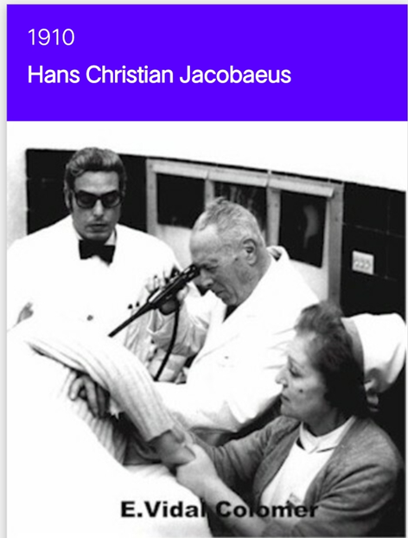
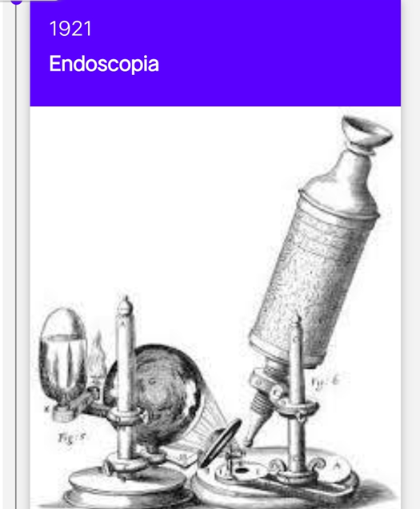
The early days of MAS Gynae SURGERY

Slide 29
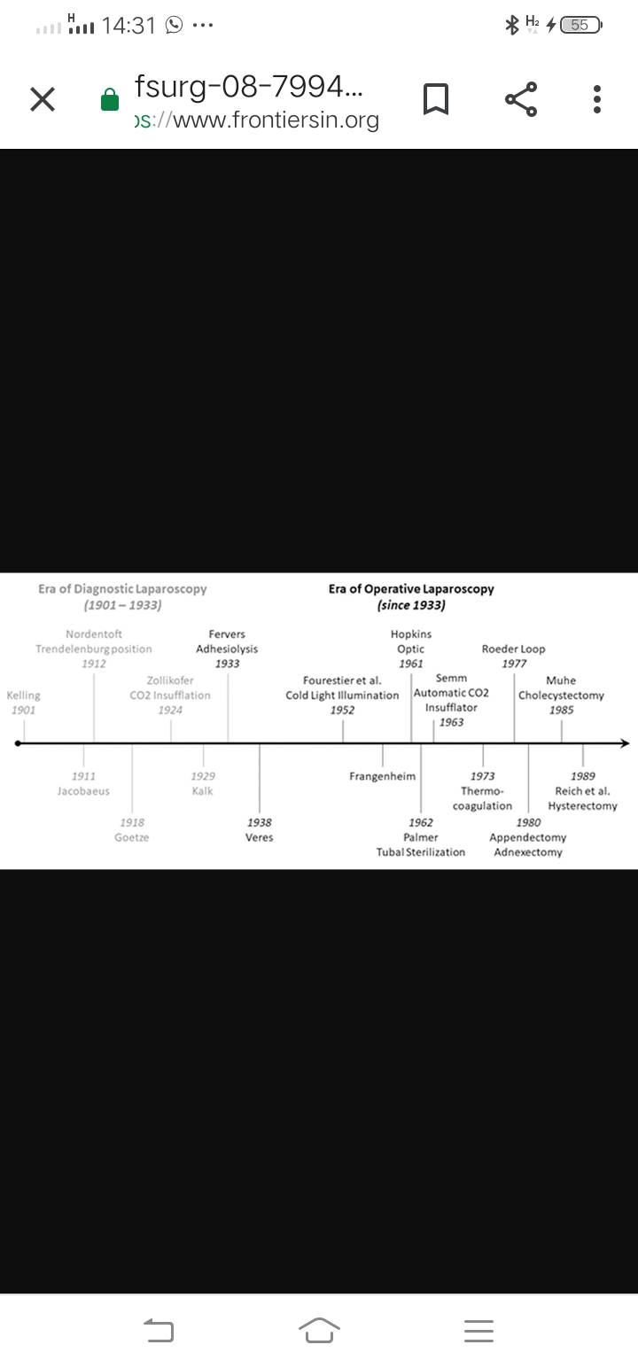

Slide 30
Advances in minimally invasive surgery
Optics and viewing systems
Eye piece teaching aid smart monitors
Sd - hd camera systems, single chip -3chip camera systems
Cameras with archiving systems
Enhanced /angled telescopes
Entry
Veress needle , hassons port entry, video assisted entry
Safety trocars and cannulas
Distention and pneumoperitoneum
Innovations in different fluid and gases
Dissection
Sharp, Blunt, monopolar bipolar ultrasonic devices
Retrieval
Direct , reducer, bags ,morcellation, return of morcellation, intrauterine morcellation
Instruments
Curved instruements, andgled and rotatory instruments
Access
Multiple ports , SILS
Robotic surgery

Slide 31
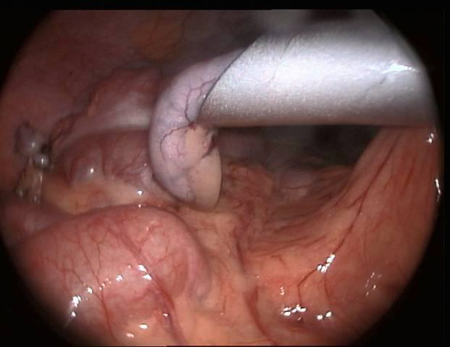
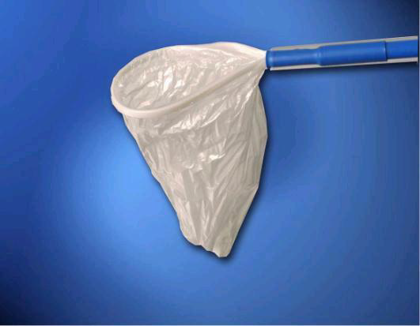
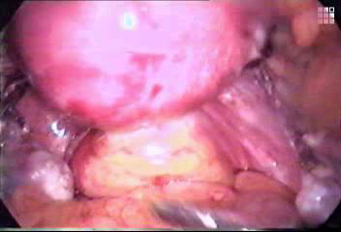
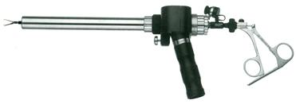
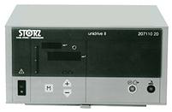

Slide 32
The future of gynaecological surgery [6,16]
Single incision laparoscopic surgery Robot assisted single incision laparoscopic surgery
Comparable rates & outcomes of transavaginal and laparoscopic hysterectomy
Gasless laparoscopy (esp useful for patients with contraindication to pneumoperitoneum)
Robot assisted laparoscopic myomectomy
Robot assisted transabdominal cerclage
ERAS-enhanced recovery after surgery: evidence based perioperative care [17,18)
Shown in metaanalysis to be associated with
decreased hospital length of stay of 1.6 days,
32% reduction in complication rate
20% reduction in readmission
no difference in 30-day postoperative mortality
and mean cost savings of $2129 USD per patient

Slide 33
Enhanced recovery after surgery (16,22,23]
Implementation challenge | Level of evidence | recommendation
Oral perioperative intake | Clear fluids until 2 h: High Carbohydrate loading: High | Strong strong
Preoperative medications | Acetaminophen: Low NSAIDs: High Limit Gabapentinoids: High | Strong Strong strong
Intraoperative analgesia | Wound infiltration via LA-transabdominal route >epidural plane-moderate evidence | strong
Urinary drainage | Catheter out- ASAP/immediately after MIS Day 1 after laparotomy-moderate | strong
VTE prophylaxis | Stockings, pneumatic compression, LMWH, with extension-moderate | strong
Appropriate postoperative opioid | Use of multimodal analgesia: Moderate Use of a post-discharge tiered opioid prescribing guideline: Moderate Limit use of PCA: Moderate | strong
Same day discharge protocol | Should be aimed at as routine for MIS-moderate | strong

Slide 34
Artificial intelligence in gynaecological surgery [19-21]
This is a future trend which has started now
Physical AI enhances surgery more directly than virtual ai
Areas include imaging and spatial awareness. 3 dimensional printing (3DP); gives surgeon better image than the 2dimensional,
the 3DP image would assisted in planning to calculate the depth, extent, and involvement of the adjacent structures and how to proceed accordingly. For difficult endometriosis surgeries
AI would enhance accuracy, decrease operative time and operative complications
This would further enhance and improve robotic surgery rates
Virtual AI
uses established patient factors, repetitive patterns, and treatment algorithms to predict the outcome
More useful in clinical work than on the surgical field
Useful for case selection for surgery and possible prognosis
Useful in screening and prognostication of gynaecological cancers

Slide 35
‘‘There is nothing so difficult or dangerous as to change the order of things’’
Machiavelli

Slide 36
WHAT the gynaecological surgery team members should EXPECT
Anaesthesiologist
Innovations to deal with demands of newer routes, pain mgt, early patient recovery & discharge home
Technicians-anaesthetic & surgical
Assistants: safety staff
Other supporting staff
Technical & IT
Management and administration
SURGEON
Sub-specialization and super-specialization
More demand for training
Advanced & simulation based learning modules
Rising need for technicians
PON
Specialization, training, retraining, simulation
Care and understanding of sophisticated equipment and instruments
Need for technicians rising

Slide 37
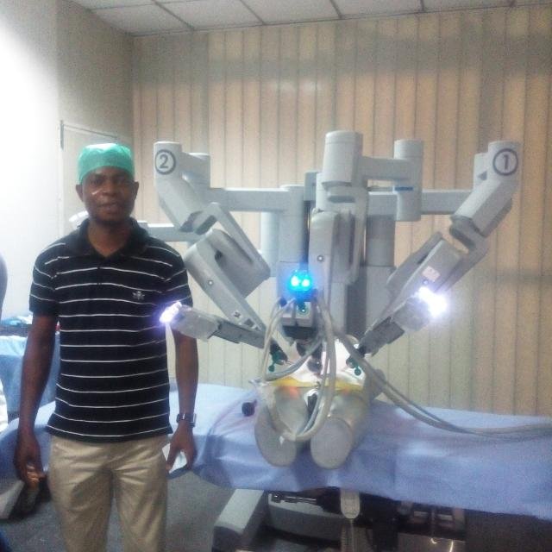
Since September, 2015- my view of the future of gynaecological surgery
Me and the da Vinci surgical robot, 2015, Delhi, India

Slide 38
conclusion
Gynecological surgery has witnessed tremendous evolution in recent times and a shift in paradigm from extensive anatomical exposure and search to minimal invasiveness and conservation of natural, aesthetic, reproductive and occupational capability; despite optimal care for varying severity of disease conditions.

Slide 39
Thank you!
For the attention

Slide 40
References
1. Atlee WL. Removal of fibrous tumour of the uterus. Am J Med Sci 1845; 11:309-35
2. Chamberlain G. The master of myomectomy. J R Soc Med. 2003; 96(6): 302-304
3. Bonney V. The fruits of conservation. J. Obstet Gynaecol Br Emp. 1937;44:1-12
4. Bonney V. extended myomectomy and ovarian cystectomy. London: cassell, 1946
5. Wallwiener D, Becker S. Perspectives in gynecologic surgery: past, present and future. Gynecol Surg (2004) 1:63–65
6. Wesevich V, Webster EM, Baxley SE. Overcoming challenges in minimally invasive gynecologic surgery
Gynecol Pelvic Med 2020;3:35
7. Parvez T, Saldanha C. Recent Advances and Future Trends in Obstetrics and Gynaecology. JIMSA. 2012. 25(3); 155-157
8. Di Donato V, Bogani G, Casarin J, Ghezzi F, Malzoni M, Falcone F, et al. Ten year outcomes following laparoscopic and open abdominal radical hysterectomy for “low-risk” early-stage cervical cancer: a propensity-score based analysis. Gynecol Oncol. (2023) 174:49–54.

Slide 41
References
Lecointre L, Pellerin M, Venkatasamy A, Fabacher T, Eberst L, Gantzer J, et al. Complete laparoscopic interval debulking surgery for advanced ovarian cancer achieves similar survival outcomes to open approach: a propensity-matched study. J Investig Surg Off J Acad Surg Res. (2022) 35:1394–401.
Giannini A and Laganà AS (2024) Editorial: Minimally invasive surgery in gynecology oncology: current trends and controversies. Front. Med. 10:1353534.
Lee S, Kim M, Seong SJ, Paek J, LEE YS, Nam EJ, et al. Trends in robotic surgery in Korean gynecology. Gyne Robot Surg 2020;1(2):50-56
Di Donna MC, Cucinella G, Zaccaria G, Lo Re G, Crapanzano A, Salerno S, et al. Concordance of radiological, laparoscopic and laparotomic scoring to predict complete cytoreduction in women with advanced ovarian cancer. Cancers. (2023) 15:500. doi: 10.3390/cancers15020500
Zhu X, Xi H, Li Z and Wang X (2023) Trends in surgical approaches and adnexal surgeries during hysterectomies for benign diseases between 2015–2021. Front. Surg. 10:1068776.
Badejoko OO, Awowole IO, Imaralu JO, Adeyemi AB, Orji EO, Kuti O. Laparoscopic salpingectomy for heterotopic pregnancy; a case report from Ile-Ife, Nigeria. Journal of Gynecologic Surgery. 2013; 29:(2):96-98.
Moawad GN, Tyan P, Bracke T, et al. Systematic Review of Transabdominal Cerclage Placed via Laparoscopy for the Prevention of Preterm Birth. J Minim Invasive Gynecol 2018;25:277-86.
Nelson aG, Fotopouloub JC, Taylor c, Glaser d, Bakkum-Gamez d, L.A. Meyer et al. Enhanced recovery after surgery (ERAS®) society guidelines for gynecologic oncology: Addressing implementation challenges - 2023 update. Gynecologic Oncology 173 (2023) 58–67

Slide 42
References
G. Nelson, J. Bakkum-Gamez, E. Kalogera, et al., Guidelines for perioperative care in gynecologic/oncology: enhanced recovery after surgery (ERAS) society recommendations-2019 update, Int. J. Gynecol. Cancer 29 (4) (2019) 651–668.
S.P. Bisch, C.A. Jago, E. Kalogera, et al., Outcomes of enhanced recovery after surgery (ERAS) in Gynecologic oncology - a systematic review and meta-analysis, Gynecol. Oncol. 161 (1) (2021) 46–55.
Moawad G, Tyan P, Louie M: Artificial intelligence and augmented reality in gynecology . Curr Opin Obstet Gynecol. 2019, 31:345-48.
Waran V, Narayanan V, Karuppiah R, Owen SL, Aziz T: Utility of multimaterial 3D printers in creating models with pathological entities to enhance the training experience of neurosurgeons. J Neurosurg. 2014, 120:489-92.
Ajao MO, Clark NV, Kelil T, Cohen SL, Einarsson JI: Case report: three-dimensional printed model for deep infiltrating endometriosis. J Minim Invasive Gynecol. 2017, 24:1239-42
G. Nelson, A.D. Altman, A. Nick, et al., Guidelines for pre- and intra-operative care in gynecologic/oncology surgery: Enhanced Recovery After Surgery (ERAS®) Society recommendations–Part I, Gynecol. Oncol. 140 (2) (2016) 313–322
G. Nelson, A.D. Altman, A. Nick, et al., Guidelines for postoperative care in gynecologic/oncology surgery: Enhanced Recovery After Surgery (ERAS®) Society recommendations–Part II, Gynecol. Oncol. 140 (2) (2016) 323–332.

